Slide 1
G.Rajashekar Business analysis cohort-2
Capstone project
Restaurant management system
Project-1

Slide 2
Identifying stakeholders
1.Restaurent ceo
2.Restaurent managers & other all staff
3.Customers
4.Food suppliers
5.Business analyst
6.Software developers
7.Project manager

Slide 3
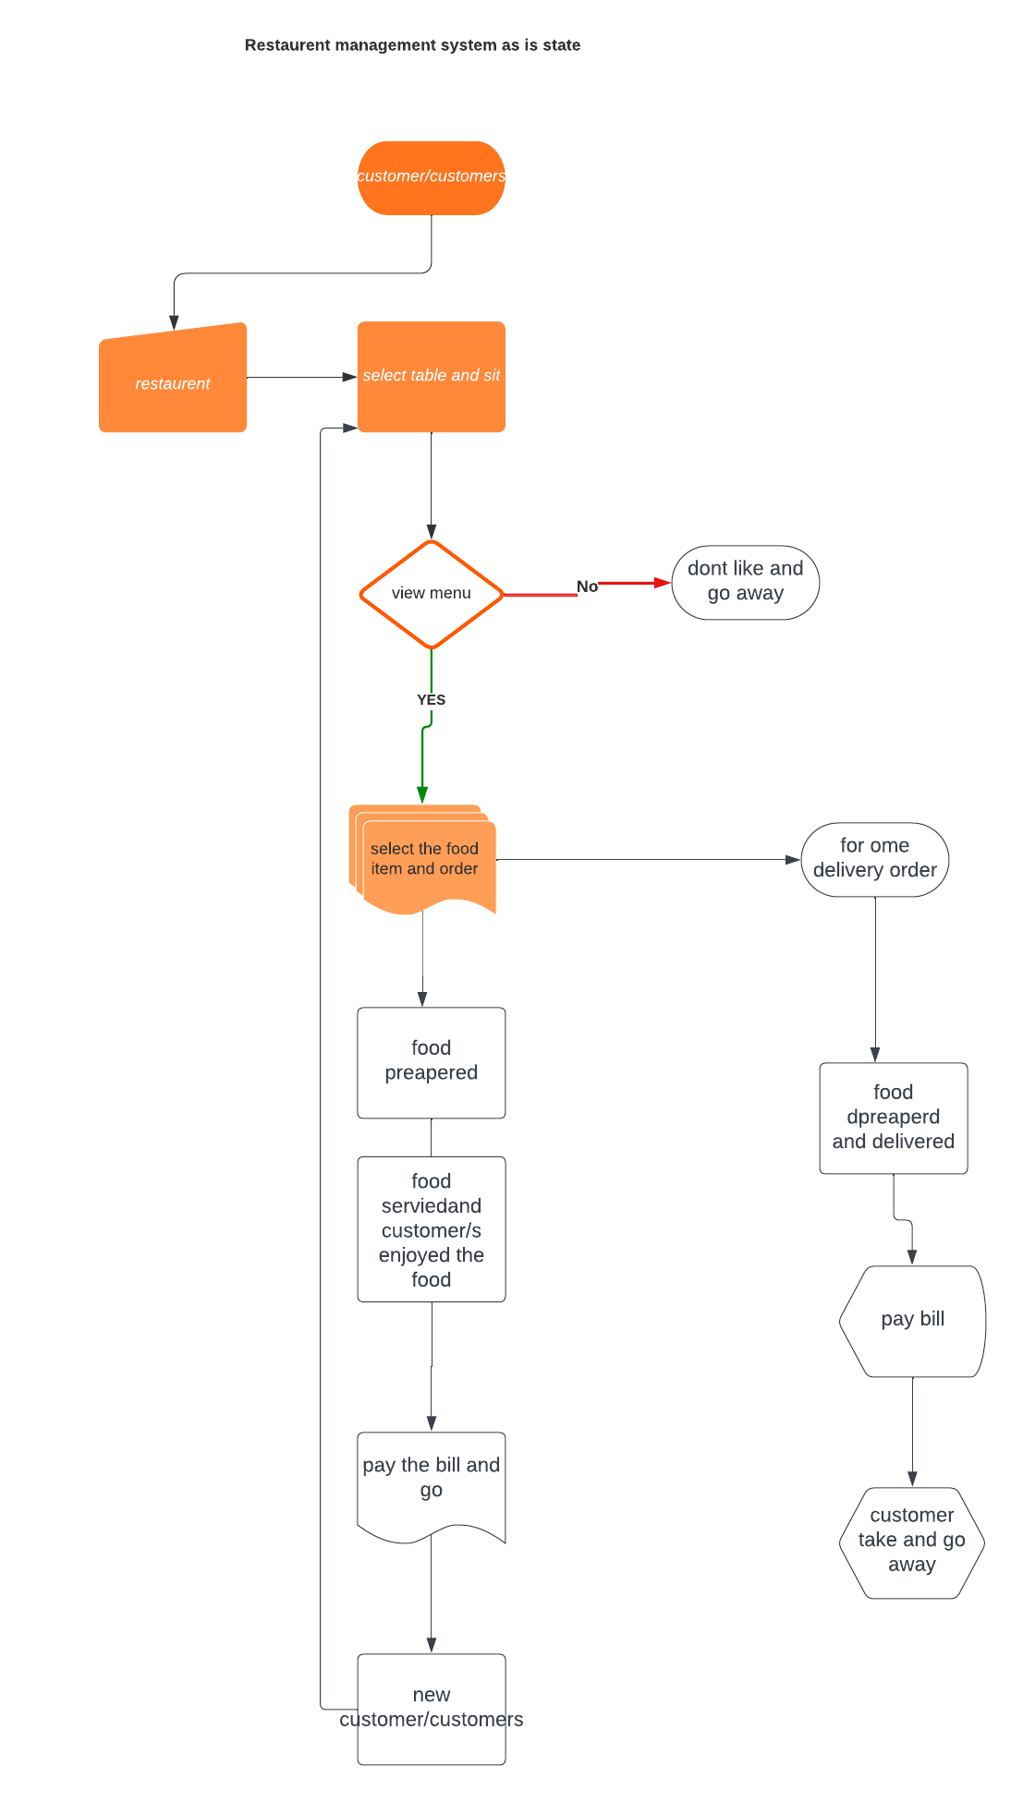
RESTARENT MANAGEMENT SYSTEM AS IS STATE

Slide 4
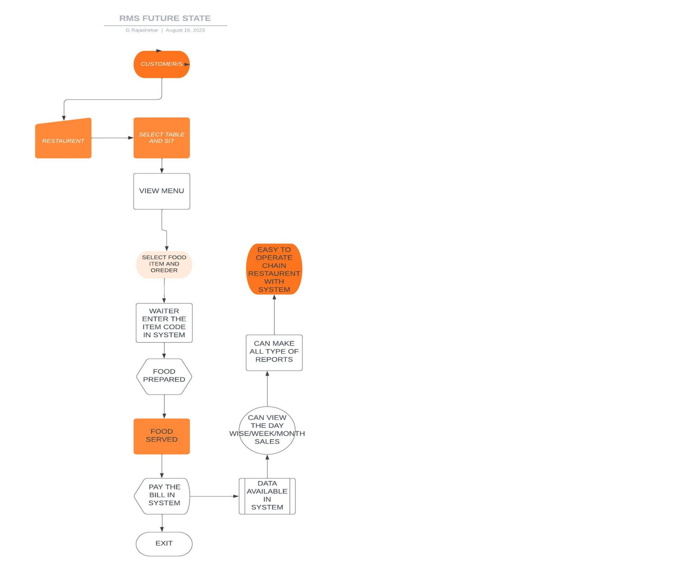
Restaurent management system future state

Slide 5
In scope and main feautures of rms
Scope of RMS
System capacity
Seating capacity
Food range availability
System knowledge for waiters
Staff availability
Bill generation
Ordering system for home delivery

Slide 6
Main feautures of RMS
Viewing menu card
Booking via system
Checking the availability of inventory and remaining food items
Checking sales periodically
No access for waiters to edit but can edit and updated by managers and ceo
Displaying all items categorically
Billing and payment gateway

Slide 7
Functional requirements
New system should easy to use
Should have Access for all staff
Able to view the menu and other food item
Able to view the reports
Can be edited and updating according to requirement/s
System should have table booking option
Should be available for 24/7
Should have inventory management
Should have option to view fast moving dishes and slow and non moment dishes details

Slide 8
Non functional requirements
System availability
Training for staff
Usability for all stakeholders
Timely updating from staff

Slide 9

RMS MOCKUP SCREENS
THE GRILL HOUSE

Slide 10
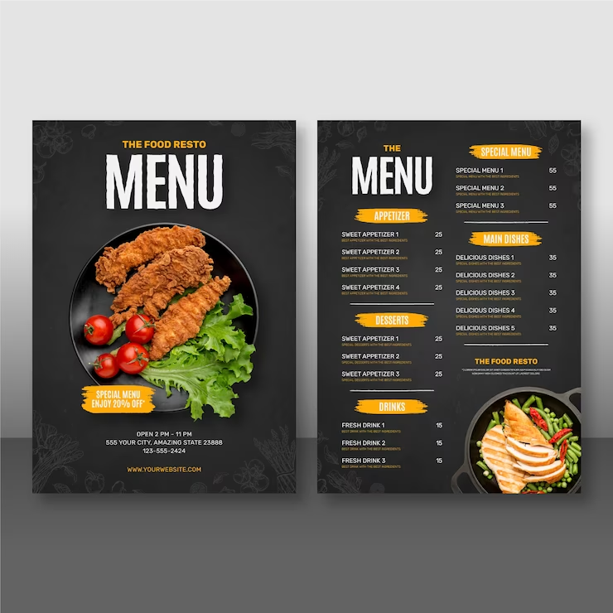
MENU CARD
www.thegrillhouse.com/menu

Slide 11

TABLE RESERVATION BAR
www.thegrillhouse.com/tablereservation
SELECT TABLE FOR RESERVATION-1
2
3

Slide 12
RESTAURENT TABLEAU LINKS
https://public.tableau.com/app/profile/g.rajashekar/viz/BacapstoneprojectRMS/MONTHWISE?publish=yes
https://public.tableau.com/app/profile/g.rajashekar/viz/BacapstoneprojectRMS/ZONEWISE?publish=yes
https://public.tableau.com/app/profile/g.rajashekar/viz/BacapstoneprojectRMS/TOTALSALE?publish=yes

Slide 13
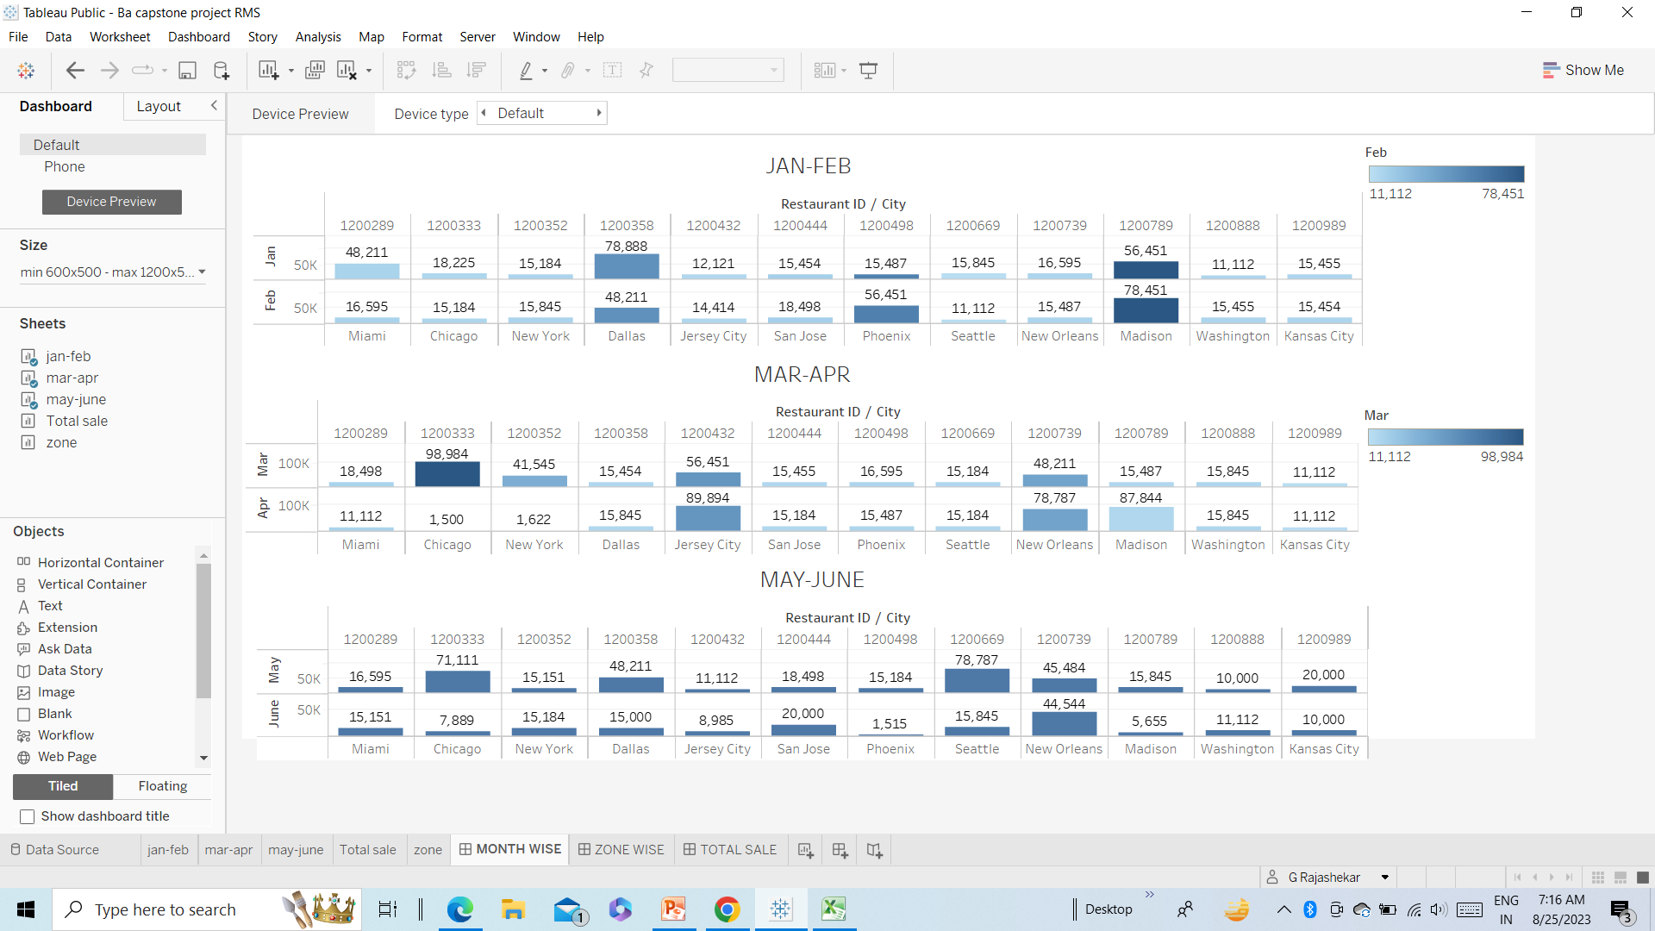
GRILL HOUSE MONTH WISE SALES

Slide 14
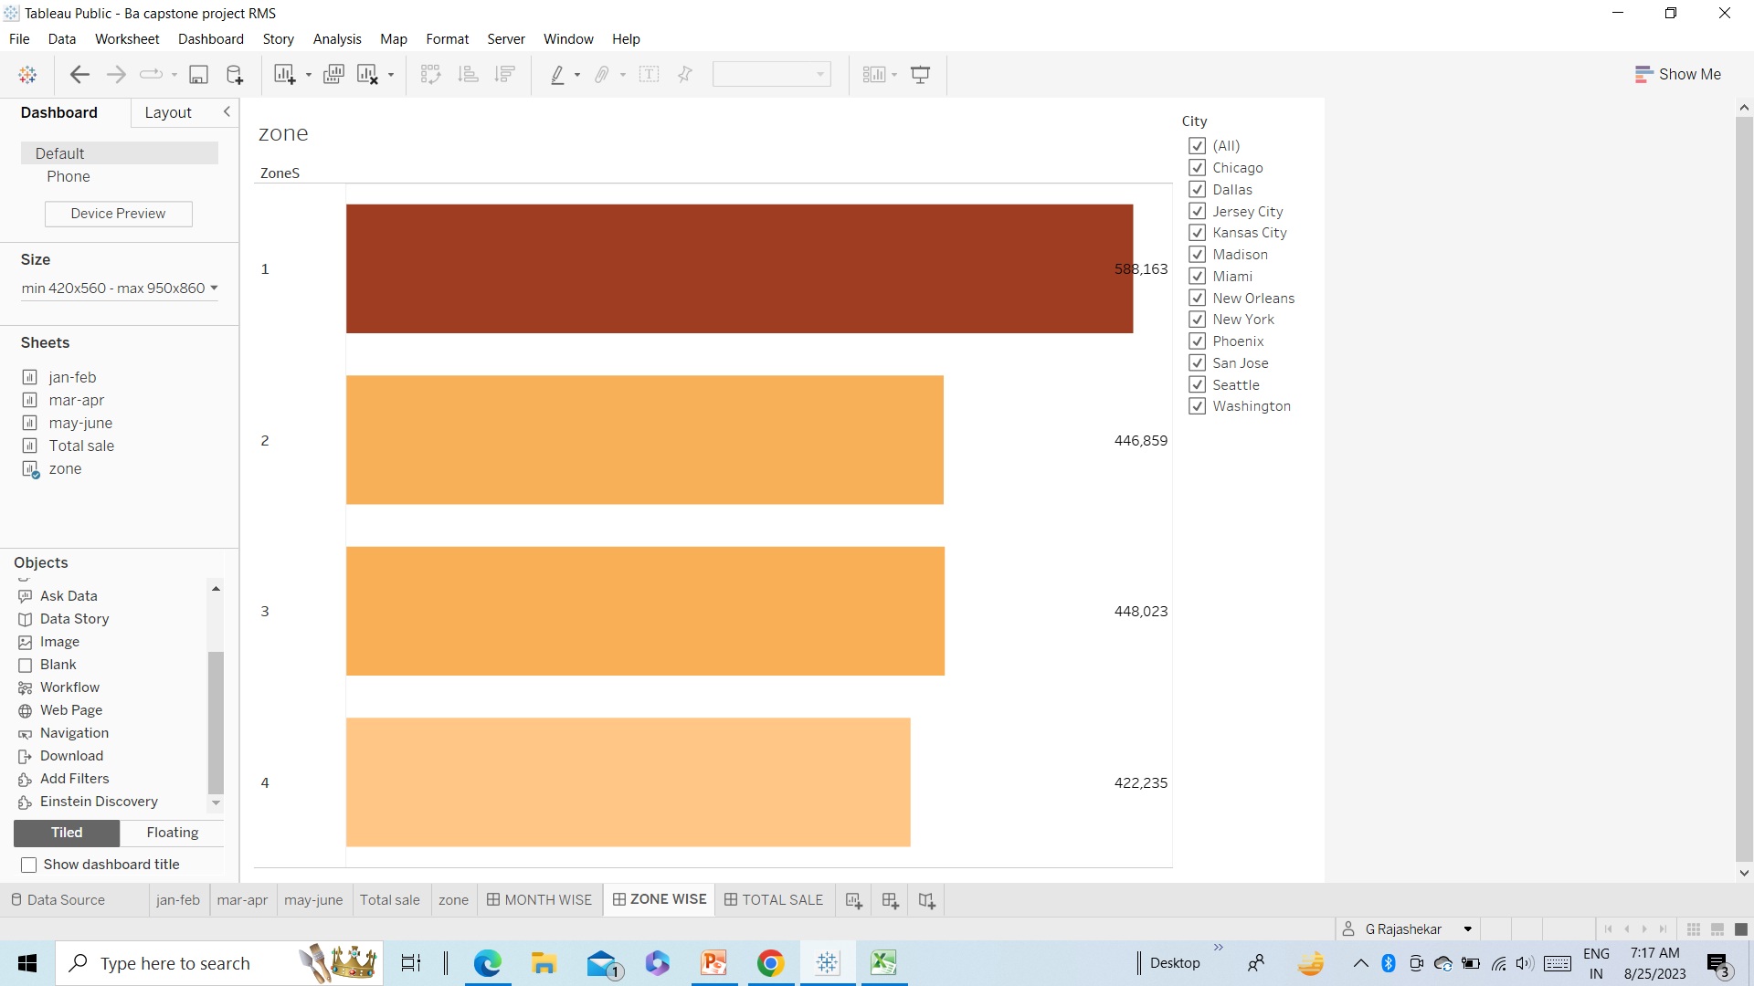
THE GRILL HOUSE ZONEWISE SALES

Slide 15
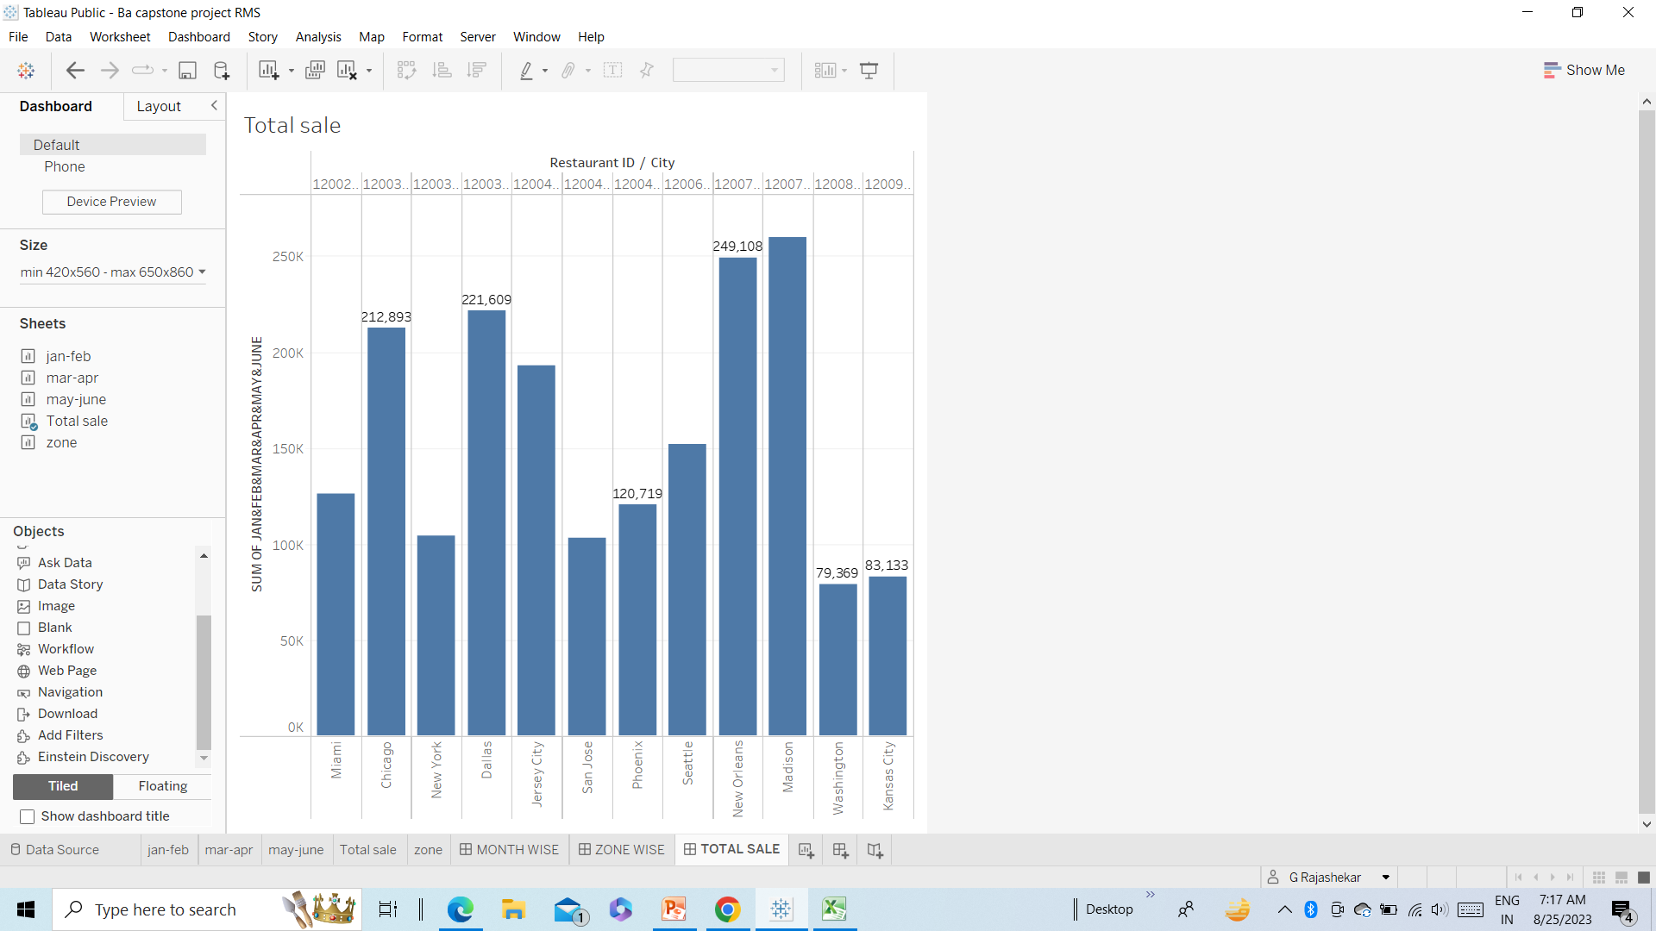
THE GRILL HOUSE TOTAL SALES

Slide 16
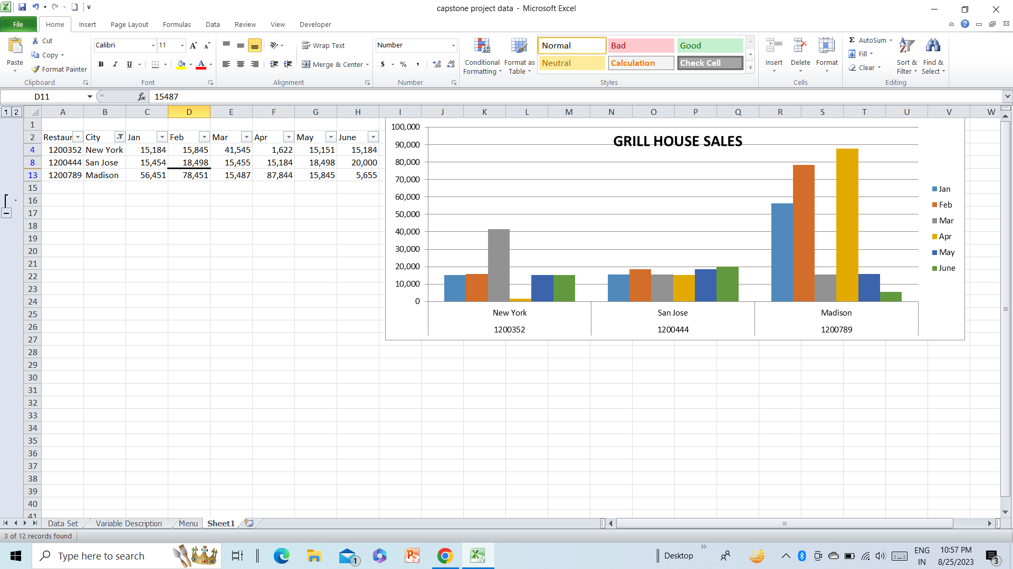
THE GRILL HOUSE SALES

Slide 17
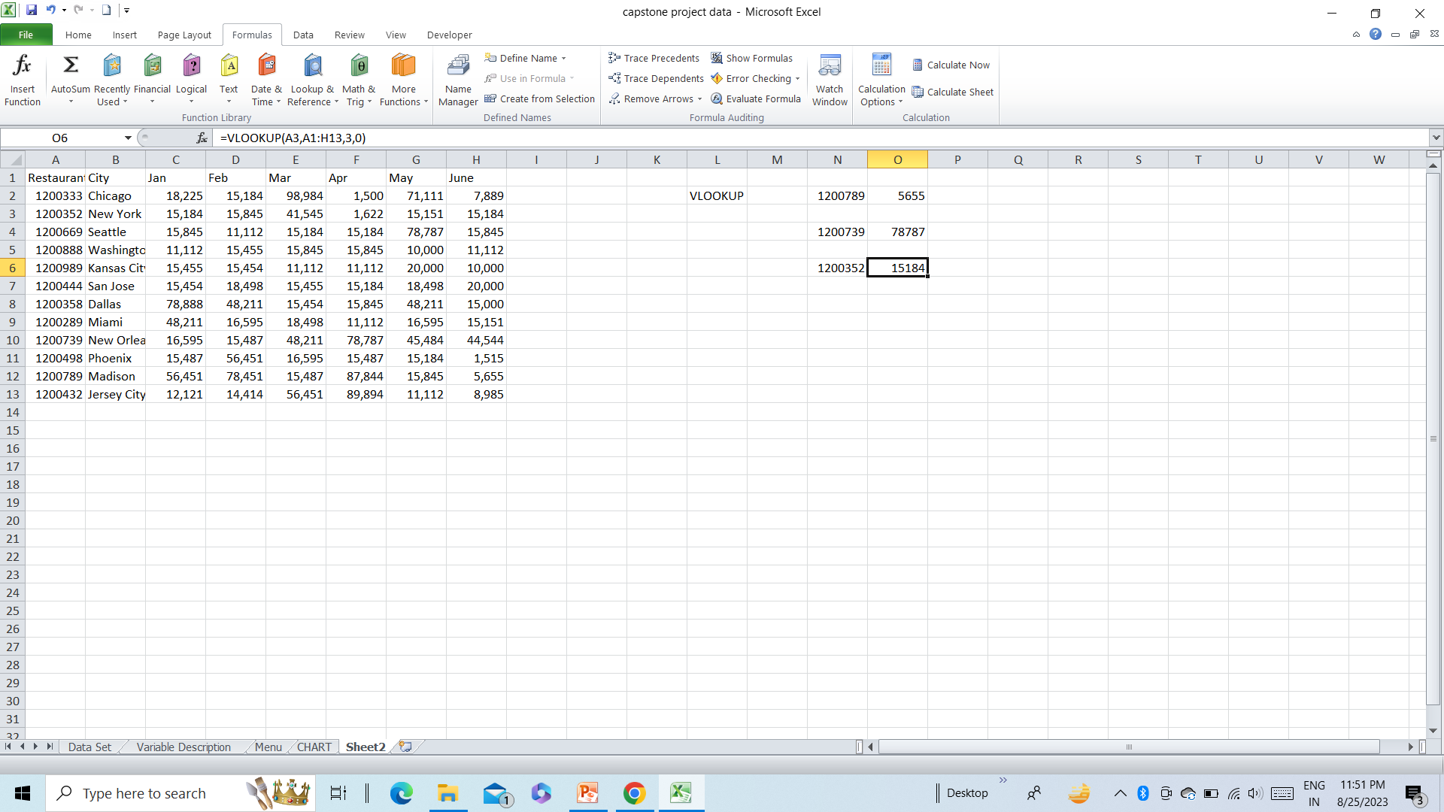
VLOOKUP DATA

Slide 18
VLOOKUP FORMULAS
1. =VLOOKUP(A12,A1:H13,8,0)=5655
2. =VLOOKUP(A10,A1:H13,6,0)=78787
3. =VLOOKUP(A3,A1:H13,3,0)=15184

